Slide 1

An Introduction to Software Engineering
Software Engineering
Lect-1

Slide 3
Objectives
To introduce software engineering and to explain its importance.
To set out the answers to key questions about software engineering.
To introduce ethical and professional issues and to explain why they are of concern to software engineers.

Slide 4
Topics covered
FAQs about software engineering
Professional and ethical responsibility

Slide 5
Software engineering
The economies of ALL developed nations are dependent on software.
More and more systems are software controlled.
Software engineering is concerned with theories, methods and tools for professional software development.

Slide 6
FAQs about software engineering
What is software?
What is software engineering?
What is the difference between software engineering and computer science?
What is the difference between software engineering and system engineering?
What is a software process?
What is a software process model?

Slide 7
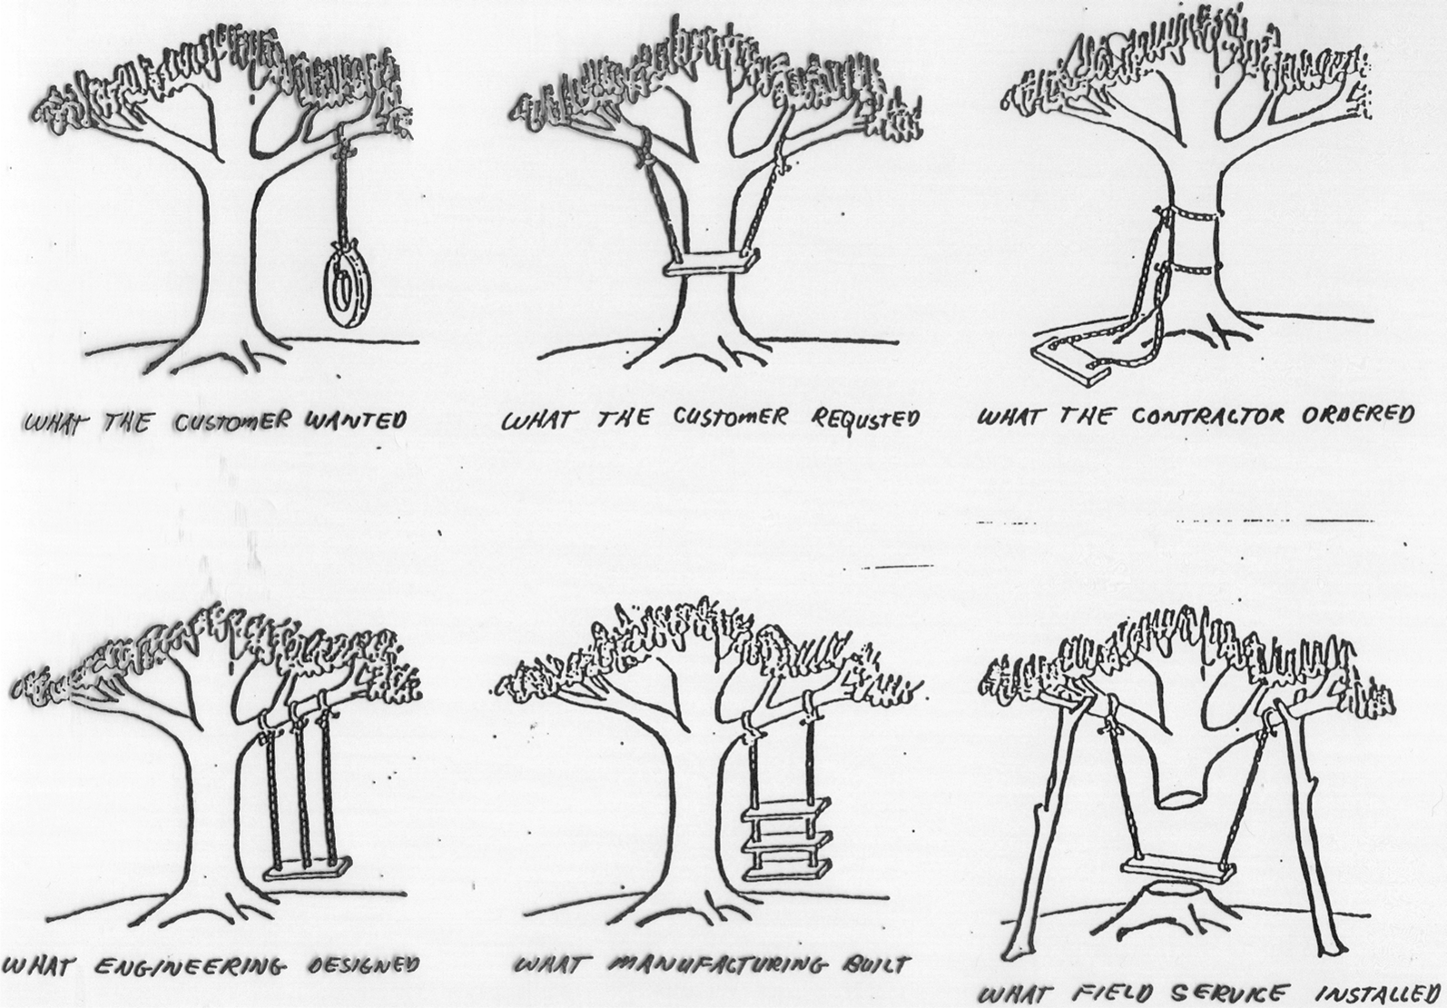

Slide 8
What is software?
Computer programs and associated documentation such as requirements, design models and user manuals.
Software products may be developed for a particular customer or may be developed for a general market.
Software products may be
  Generic - developed to be sold to a range of different customers e.g. PC software such as Excel or Word.
  Bespoke (custom) - developed for a single customer according to their specification.
New software can be created by developing new programs, configuring generic software systems or reusing existing software.

Slide 9
What is the difference between
software engineering and computer science?
Computer science is concerned with theory and fundamentals; software engineering is concerned with the practicalities of developing and delivering useful software.
Computer science theories are still insufficient to act as a complete underpinning for software engineering (unlike e.g. physics and electrical engineering).

Slide 10
What is the difference between software engineering and system engineering?
System engineering is concerned with all aspects of computer-based systems development including hardware, software and process engineering. Software engineering is part of this process concerned with developing the software infrastructure, control, applications and databases in the system.
System engineers are involved in system specification, architectural design, integration and deployment.

Slide 11
What is a software process?
A set of activities whose goal is the development or evolution of software.
Generic activities in all software processes are:
  Specification - what the system should do and its development constraints
  Development - production of the software system
  Validation - checking that the software is what the customer wants
  Evolution - changing the software in response to changing demands.

Slide 12
What is a software process model?
A simplified representation of a software process, presented from a specific perspective.
Examples of process perspectives are
  Workflow perspective - sequence of activities;
  Data-flow perspective - information flow;
  Role/action perspective - who does what.
Generic process models
  Waterfall;
  Iterative development;
  Component-based software engineering.

Slide 13
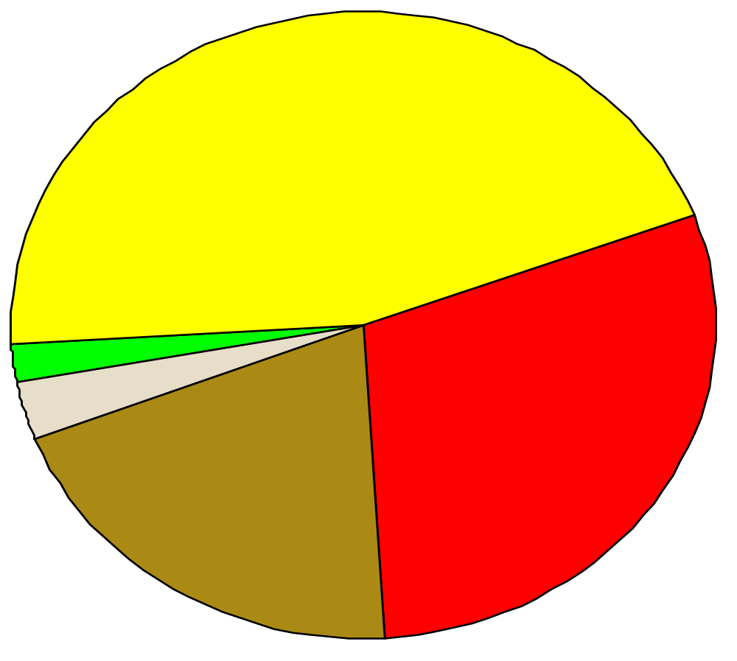
Why Software Engineering?
9 software projects totaling $96.7 million: Where The Money Went
Delivered, but never
successfully used
45%
Used as delivered
2%
Paid for, but
not delivered
30%
Usable w. rework
3%
Why?
Software hurts
Requirements
design
Used w. extensive rework,
but later abandoned
20%

Slide 14
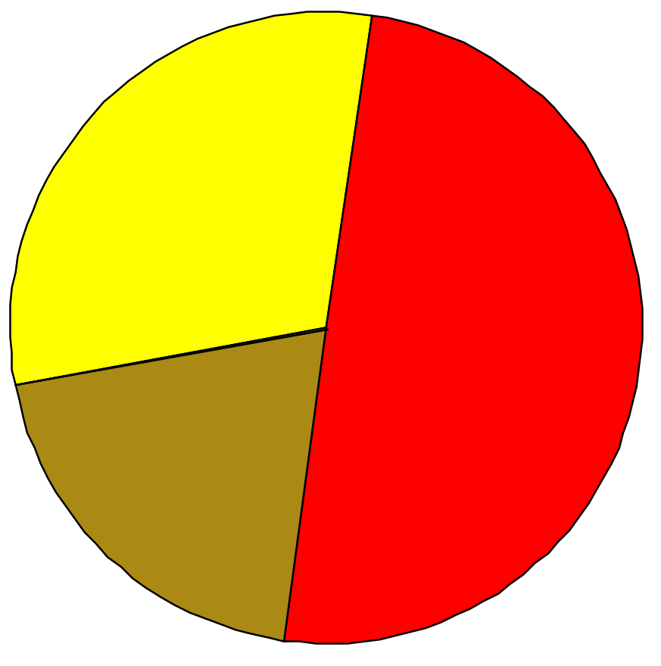
Why Software Engineering?
What do software engineers do?
Non-productive
Activities 30%
Interactio
50%
Work alone
20%
programming ≠ software engineering
personal activity team activity
small, clear problem large, nebulous problem

Slide 15
What are the costs of software engineering?
Roughly 60% of costs are development costs, 40% are testing costs. For custom software, evolution costs often exceed development costs.
Costs vary depending on the type of system being developed and the requirements of system attributes such as performance and system reliability.
Distribution of costs depends on the development model that is used.

Slide 16
What are software engineering methods?
Structured approaches to software development which include system models, notations, rules, design advice and process guidance.
Model descriptions
  Descriptions of graphical models which should be produced;
Rules
  Constraints applied to system models;
Recommendations
  Advice on good design practice;
Process guidance
  What activities to follow.

Slide 17
What is CASE
(Computer-Aided Software Engineering)
Software systems that are intended to provide automated support for software process activities.
CASE systems are often used for method support.
Upper-CASE
  Tools to support the early process activities of requirements and design;
Lower-CASE
  Tools to support later activities such as programming, debugging and testing.

Slide 18
What are the attributes of good software?
The software should deliver the required functionality and performance to the user and should be maintainable, dependable and acceptable.
Maintainability
  Software must evolve to meet changing needs;
Dependability
  Software must be trustworthy;
Efficiency
  Software should not make wasteful use of system resources;
Acceptability
  Software must accepted by the users for which it was designed. This means it must be understandable, usable and compatible with other systems.

Slide 19
What are the key challenges facing software engineering?
Heterogeneity, delivery and trust.
Heterogeneity
  Developing techniques for building software that can cope with heterogeneous platforms and execution environments;
Delivery
  Developing techniques that lead to faster delivery of software;
Trust
  Developing techniques that demonstrate that software can be trusted by its users.

Slide 20
Professional and ethical responsibility
Software engineering involves wider responsibilities than simply the application of technical skills.
Software engineers must behave in an honest and ethically responsible way if they are to be respected as professionals.
Ethical behaviour is more than simply upholding the law.

Slide 21
Issues of professional responsibility
Confidentiality
  Engineers should normally respect the confidentiality of their employers or clients irrespective of whether or not a formal confidentiality agreement has been signed.
Competence
  Engineers should not misrepresent their level of competence. They should not knowingly accept work which is out with their competence.

Slide 22
Issues of professional responsibility
Intellectual property rights
  Engineers should be aware of local laws governing the use of intellectual property such as patents, copyright, etc. They should be careful to ensure that the intellectual property of employers and clients is protected.
Computer misuse
  Software engineers should not use their technical skills to misuse other people’s computers. Computer misuse ranges from relatively trivial (game playing on an employer’s machine, say) to extremely serious (dissemination of viruses).

Slide 23
What is the Problem?
84 % of all software projects do not finish on time and within budget (Survey conducted by Standish Group)
  8000 projects in US in 1995
  More than 3o % of all projects were cancelled
  89 % over budget
Key issues:
  Software firms are always pressured to perform under unrealistic deadlines.
  The clients ask for new features, just before the end of the project, and unclear requirements.
  Software itself is awfully complex.
  Uncertainties throughout the development project.

Slide 24
Real Cases
Bank of America Master Net System
  Trust business. 1982.
  Spend 18 months in deep research & analysis of the target system.
    Original budget: 20 million.
    Original Schedule: 9 months, due on 1984/12/31.
    Not until March-1987, and spent 60 million.
    Lost 600 millions business
  Eventually, gave up the software system and 34 billion trust accounts transferred.
Other cases:
  Explosion of Ariane 5 prototype in 1996
  Explosion of Boeing’s Delta III rocket.

Slide 25
Problems of Software
General issues
  HW vs. SW
  Productivity: build new programs from scratch
  Maintenance: maintain existing programs

Slide 26
Software Myths (cont’d)
Management Myths
  We already have a book that’s full of standards and procedures for building software. Won’t that provide my people with everything they need to know?
  My people do have state-of-the-art software development tools; after all, we buy them the newest computers
  If we get behind schedule, we can add more programmers and catch up

Slide 27
Software Myths (cont’d)
Customer Myths
  A general statement of objectives is sufficient to begin writing programs – we can fill in the details later
  Project requirements continually change, but change can be easily accommodated because software is flexible

Slide 28
Software Myths (cont’d)
Practitioner’s Myths
  Once we write the program and get it to work, our job is done
  Until I get the program “running” I really have no way of assessing its quality
  The only deliverable for a successful project is the working program

Slide 29
Traditional Software Engineering
Software Systems
Function
Data
Behavior
Data Flow
Diagram
Entity-Relation
Diagram
State Transition
Diagram

Slide 30
Object-Oriented Software Engineering
Software Systems
Object
Function
Behavior
Class
Diagram
Data Flow
Diagram
State Chart

Slide 31


